Slide 1
Computer vision: models, learning and inference
Chapter 6
Learning and Inference in Vision

Slide 2
Structure
Computer vision models
Three types of model
Worked example 1: Regression
Worked example 2: Classification
Which type should we choose?
Applications
Computer vision: models, learning and inference. ©2011 Simon J.D. Prince
2

Slide 3
Computer vision models
Observe measured data, x
Draw inferences from it about state of world, w
Examples:
Observe depth map of person in living room
Infer human pose
Observe image of face
Infer identity
Observe images from two displaced cameras
Infer 3d structure of scene

Slide 4

Regression vs. Classification
Observe measured data, x
Draw inferences from it about world, w
When the world state w is continuous we’ll call this regression
When the world state w is discrete we call this classification

Slide 5
Ambiguity of visual world
Unfortunately visual measurements may be compatible with more than one world state w
Measurement process is noisy
Inherent ambiguity in visual data
Conclusion: the best we can do is compute a probability distribution Pr(w|x) over possible states of world

Slide 6
Refined goal of computer vision
Take observations x
Return probability distribution Pr(w|x) over possible worlds compatible with data
(not always tractable – might have to settle for an approximation to this distribution, samples from it, or the best (MAP) solution for w)

Slide 7


Components of solution
We need
A model that mathematically relates the visual data x to the world state w. Model specifies family of relationships, particular relationship depends on parameters θ
A learning algorithm: fits parameters θ from paired training examples x_{i},w_{i}
An inference algorithm: uses model to return Pr(w|x) given new observed data x.

Slide 8

Types of Model
The model mathematically relates the visual data x to the world state w. Every model falls into one of three categories
Model contingency of the world on the data Pr(w|x)
Model joint occurrence of world and data Pr(x,w)
Model contingency of data on world Pr(x|w)

Slide 9





Generative vs. Discriminative
Model contingency of the world on the data Pr(w|x)
(DISCRIMINATIVE MODEL)
2. Model joint occurrence of world and data Pr(x,w)
3. Model contingency of data on world Pr(x|w)
(GENERATIVE MODELS)
Generative as probability model over data and so when we draw samples from model, we GENERATE new data

Slide 10
Type 1: Model Pr(w|x) - Discriminative
How to model Pr(w|x)?
Choose an appropriate form for Pr(w)
Make parameters a function of x
Function takes parameters θ that define its shape
Learning algorithm: learn parameters θ from training data x,w
Inference algorithm: just evaluate Pr(w|x)

Slide 11
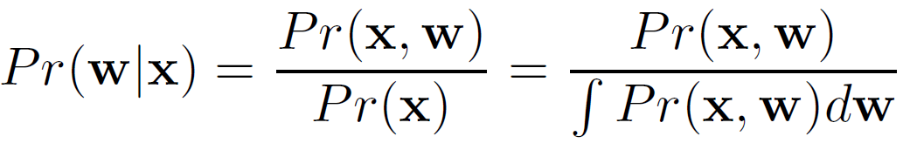
Type 2: Model Pr(x,w) - Generative
How to model Pr(x,w)?
Concatenate x and w to make z= [x^{T} w^{T}]^{T}
Model the pdf of z
Pdf takes parameters θ that define its shape
Learning algorithm: learn parameters θ from training data x,w
Inference algorithm: compute Pr(w|x) using Bayes rule

Slide 12
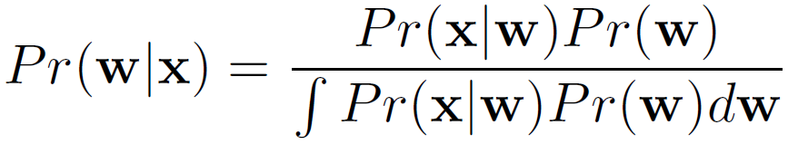
Type 3: Pr(x|w) - Generative
How to model Pr(x|w)?
Choose an appropriate form for Pr(x)
Make parameters a function of w
Function takes parameters θ that define its shape
Learning algorithm: learn parameters θ from training data x,w
Inference algorithm: Define prior Pr(w) and then compute Pr(w|x) using Bayes’ rule

Slide 13
Summary
Three different types of model depend on the quantity of interest:
Pr(w|x) Discriminative
Pr(w,x) Generative
Pr(x|w) Generative
Inference in discriminative models easy as we directly model posterior Pr(w|x). Generative models require more complex inference process using Bayes’ rule

Slide 14
Structure
Computer vision models
Three types of model
Worked example 1: Regression
Worked example 2: Classification
Which type should we choose?
Applications
Computer vision: models, learning and inference. ©2011 Simon J.D. Prince
14

Slide 15
Worked example 1: Regression
Consider simple case where
we make a univariate continuous measurement x
use this to predict a univariate continuous state w
(regression as world state is continuous)

Slide 16
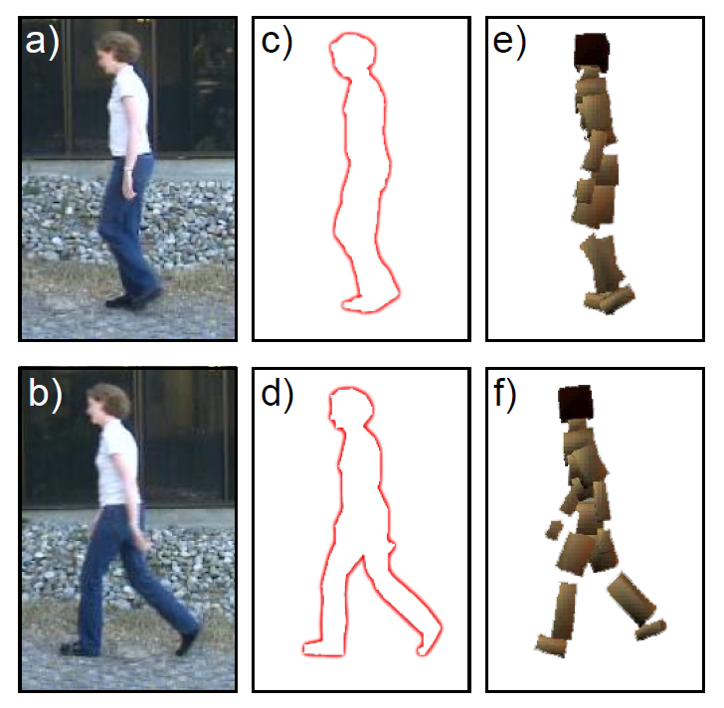


Regression application 1: Pose from Silhouette

Slide 17
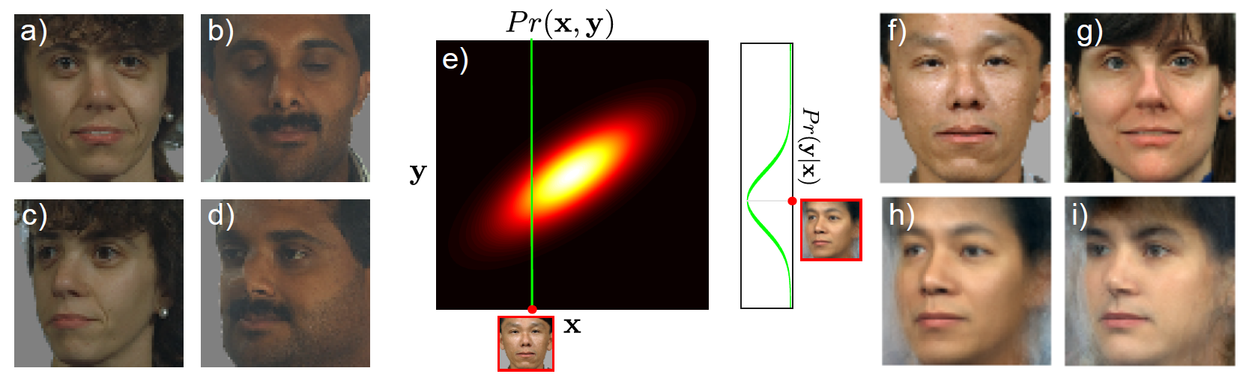
Regression application 2: Changing face pose

Slide 18
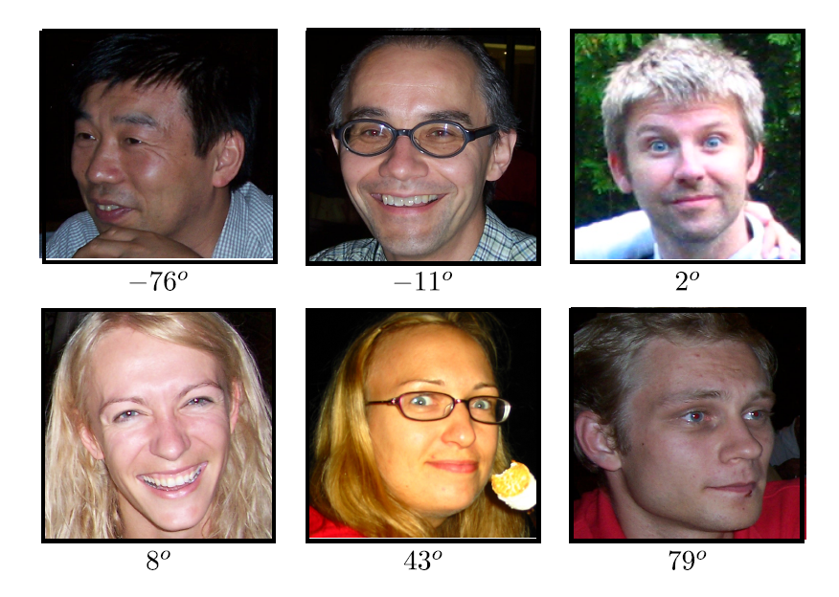
Regression application 3: Head pose estimation

Slide 19
Worked example 1: Regression
Consider simple case where
we make a univariate continuous measurement x
use this to predict a univariate continuous state w
(regression as world state is continuous)

Slide 20
Type 1: Model Pr(w|x) - Discriminative
How to model Pr(w|x)?
Choose an appropriate form for Pr(w)
Make parameters a function of x
Function takes parameters θ that define its shape
Learning algorithm: learn parameters θ from training data x,w
Inference algorithm: just evaluate Pr(w|x)

Slide 21
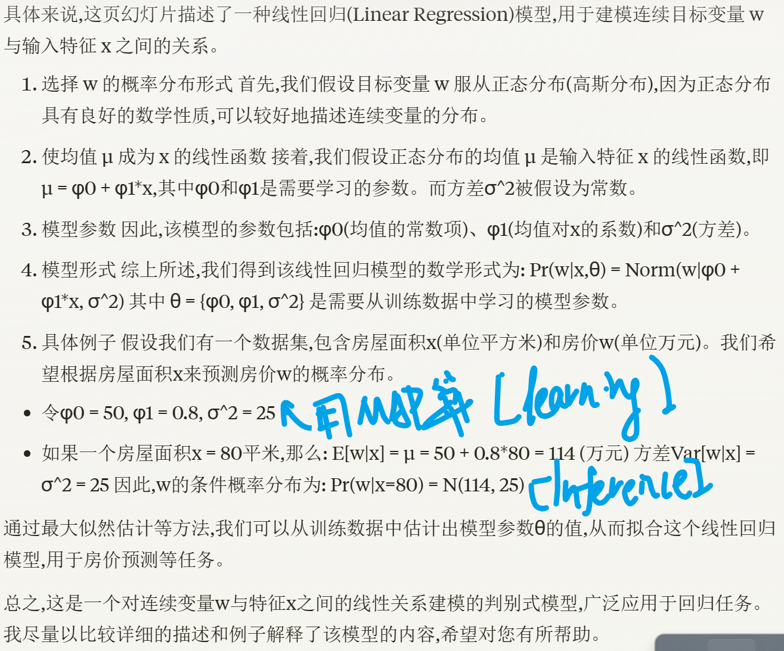
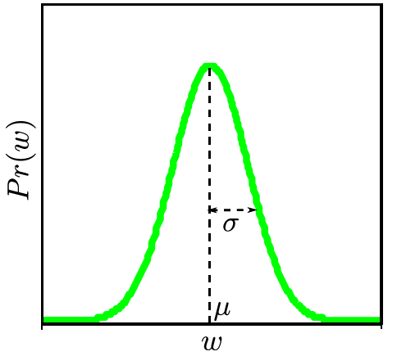
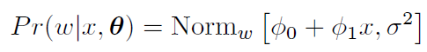
Type 1: Model Pr(w|x) - Discriminative
How to model Pr(w|x)?
Choose an appropriate form for Pr(w)
Make parameters a function of x
Function takes parameters θ that define its shape
Choose normal distribution over w
Make mean μ linear function of x (variance constant)
Parameters are φ₀, φ₁, σ².
This model is called linear regression.

Slide 22
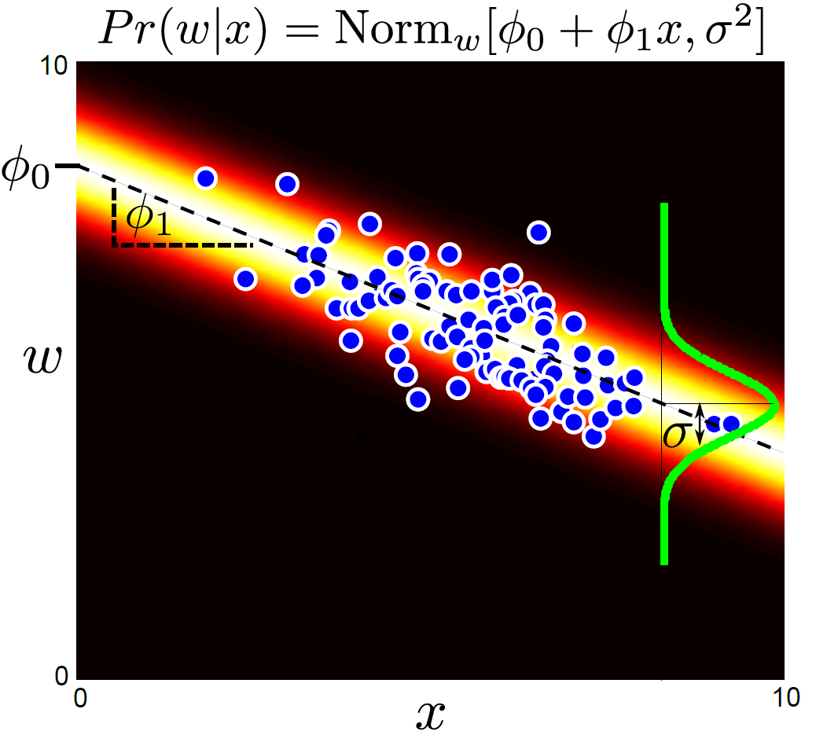
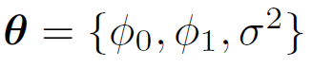

Parameters are y-offset, slope and variance

Slide 23
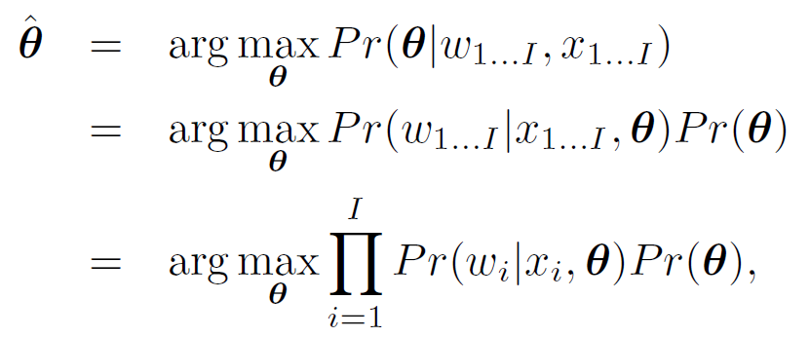
Learning algorithm: learn θ from training data x,w. E.g. MAP

Slide 24
Inference algorithm: just evaluate Pr(w|x) for new data x

Slide 25
Type 2: Model Pr(x,w) - Generative
How to model Pr(x,w)?
Concatenate x and w to make z= [x^{T} w^{T}]^{T}
Model the pdf of z
Pdf takes parameters θ that define its shape
Learning algorithm: learn parameters θ from training data x,w
Inference algorithm: compute Pr(w|x) using Bayes rule

Slide 26
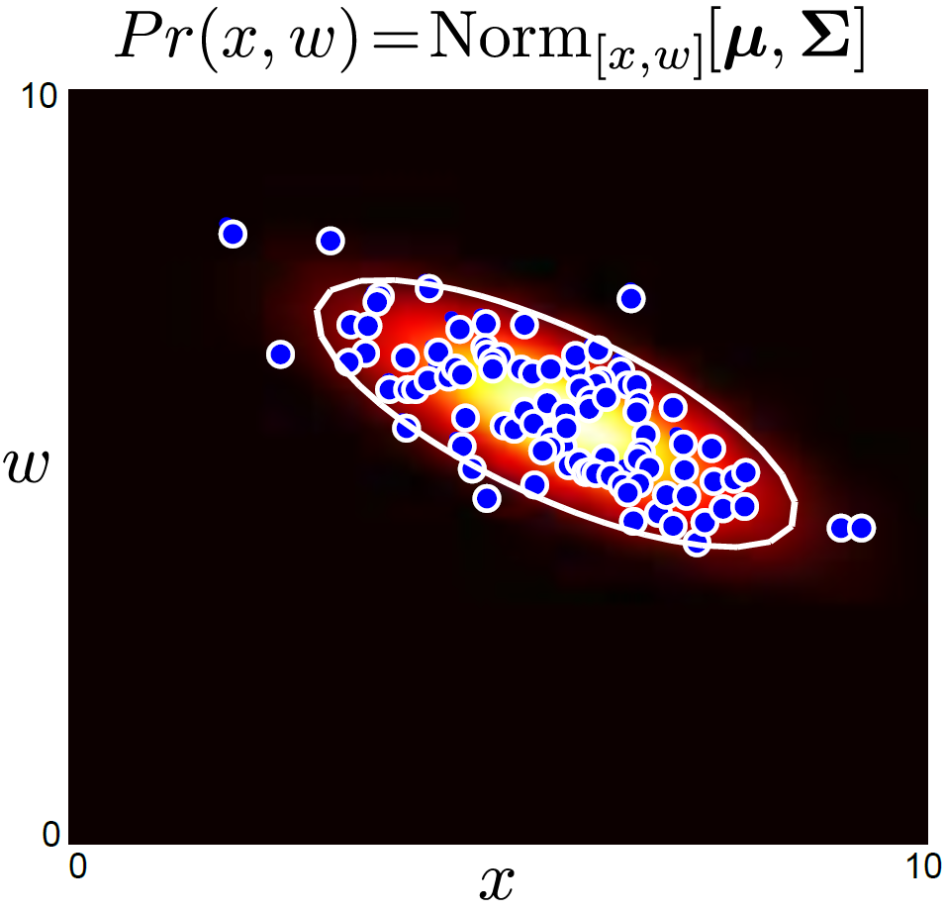
Type 2: Model Pr(x,w) - Generative
How to model Pr(x,w)?
Concatenate x and w to make z= [x^{T} w^{T}]^{T}
Model the pdf of z
Pdf takes parameters θ that define its shape
Concatenate x and w to make z= [x^{T} w^{T}]^{T}
Model the pdf of z as normal distribution.
Pdf takes parameters μ and Σ that define its shape

Slide 27
Learning algorithm: learn parameters θ from training data x,w

Slide 28
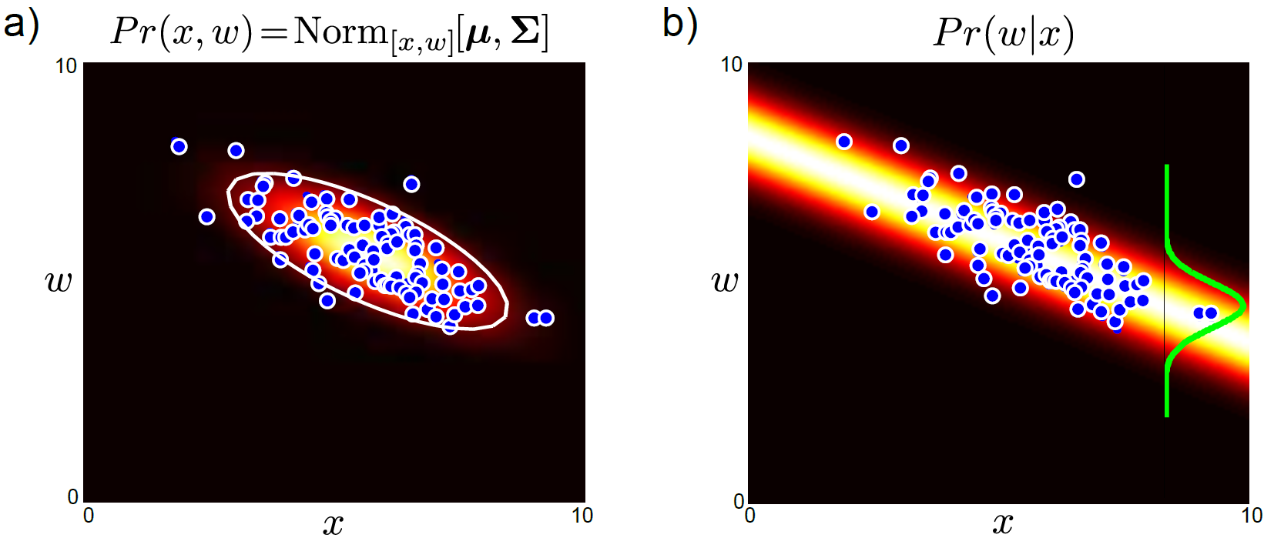


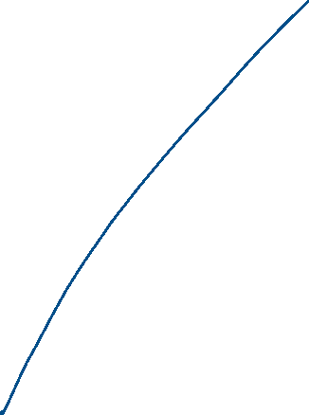
Inference algorithm: compute Pr(w|x) using Bayes rule
(normalize each column in figure)

Slide 29
Type 3: Pr(x|w) - Generative
How to model Pr(x|w)?
Choose an appropriate form for Pr(x)
Make parameters a function of w
Function takes parameters θ that define its shape
Learning algorithm: learn parameters θ from training data x,w
Inference algorithm: Define prior Pr(w) and then compute Pr(w|x) using Bayes’ rule

Slide 30
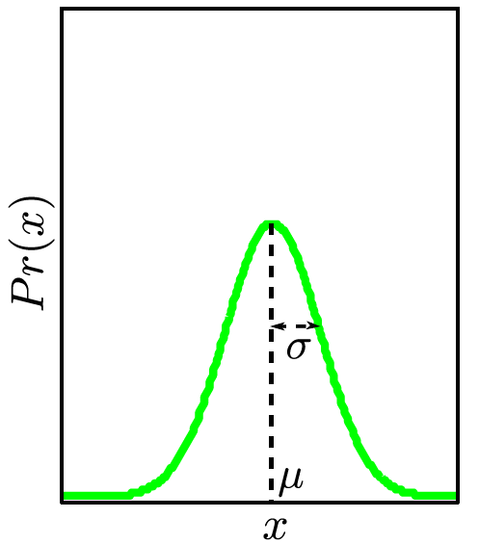
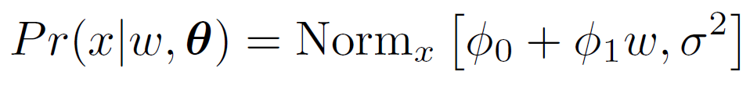
Type 3: Pr(x|w) - Generative
How to model Pr(x|w)?
Choose an appropriate form for Pr(x)
Make parameters a function of w
Function takes parameters θ that define its shape
Choose normal distribution over x
Make mean μ linear function of w (variance constant)
Parameters are φ₀, φ₁, σ².

Slide 31
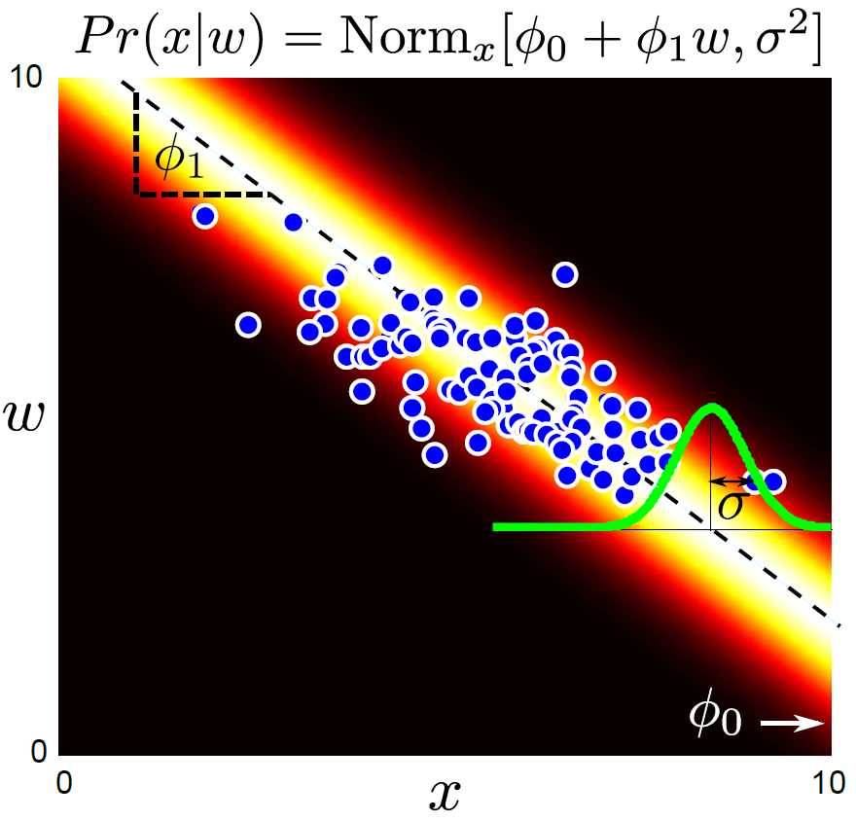
Learning algorithm: learn θ from training data x,w. e.g. MAP

Slide 32
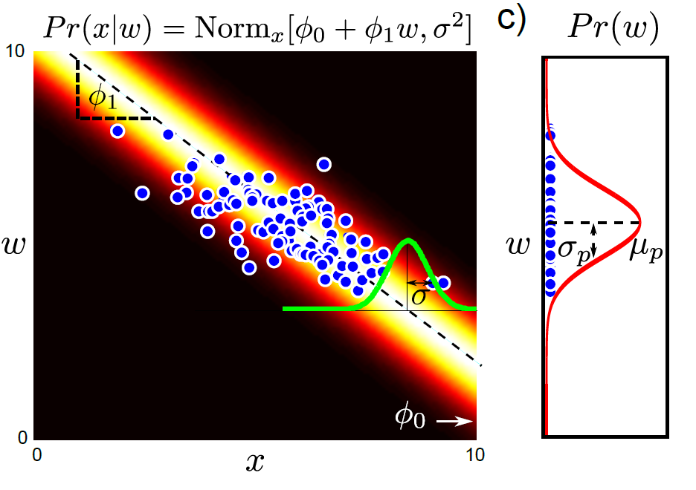
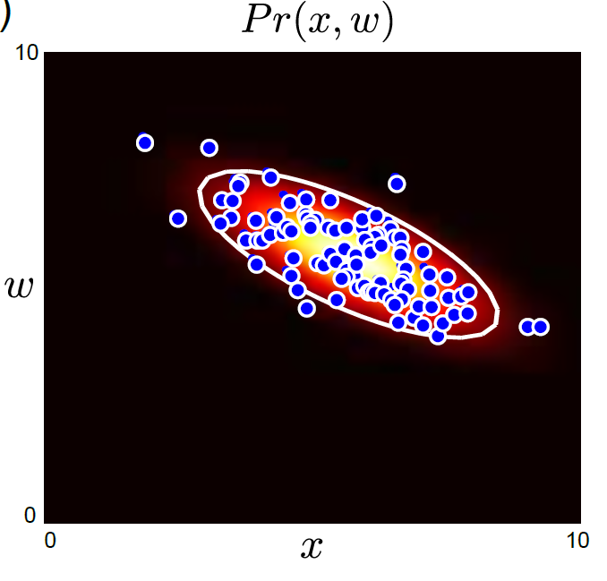
Pr(x|w) x Pr(w) = Pr(x,w)
Can get back to joint probability Pr(x,y)

Slide 33
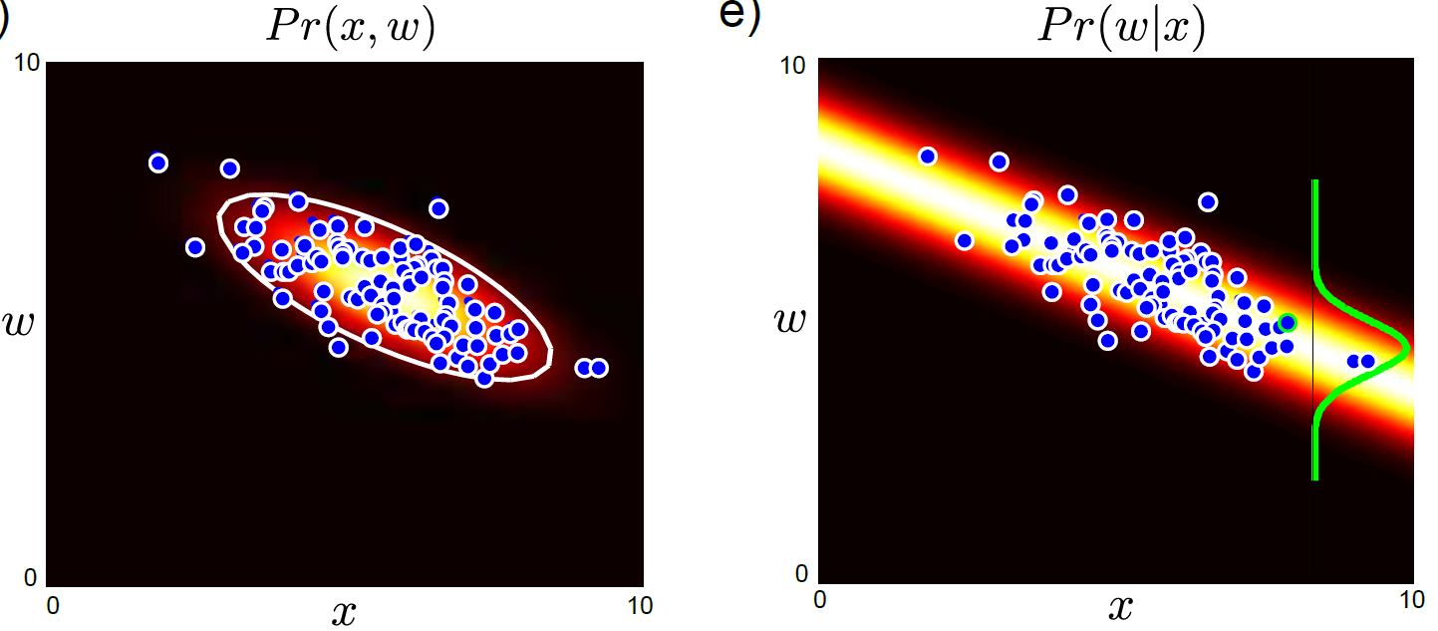
Inference algorithm: compute Pr(w|x) using Bayes rule

Slide 34
Structure
Computer vision models
Three types of model
Worked example 1: Regression
Worked example 2: Classification
Which type should we choose?
Applications
Computer vision: models, learning and inference. ©2011 Simon J.D. Prince
34

Slide 35
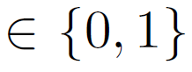
Worked example 2: Classification
Consider simple case where
we make a univariate continuous measurement x
use this to predict a discrete binary world w
(classification as world state is discrete)

Slide 36
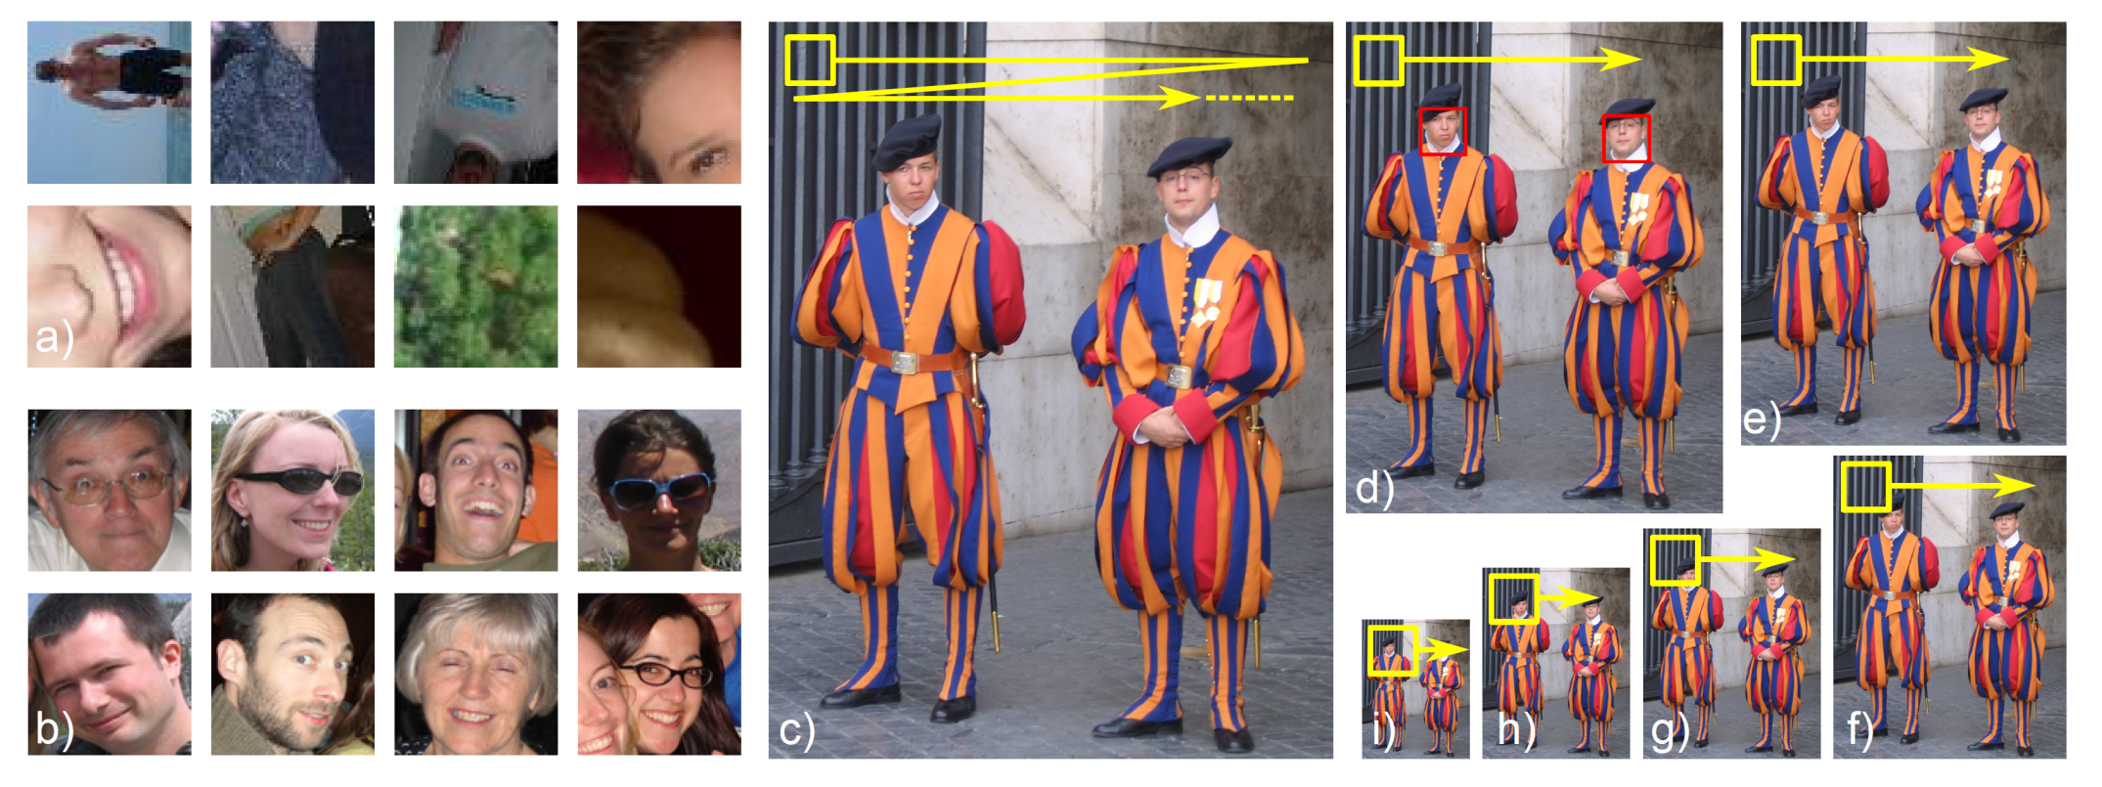
Classification Example 1: Face Detection

Slide 37
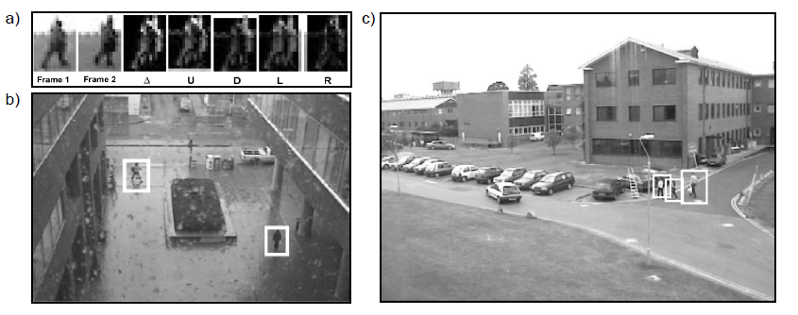
Classification Example 2: Pedestrian Detection

Slide 38
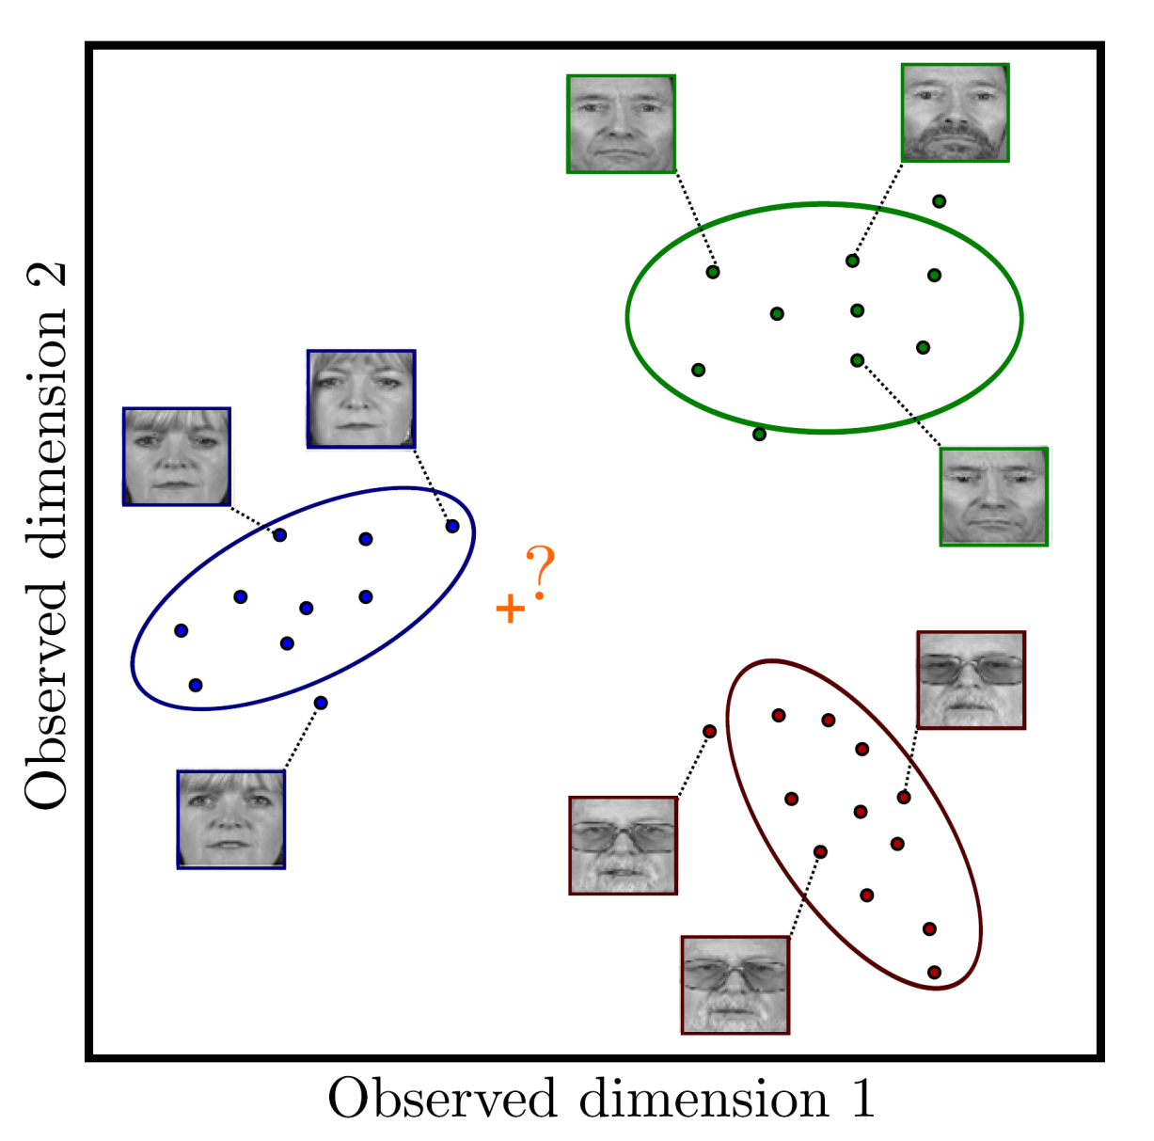
Classification Example 3: Face Recognition

Slide 39
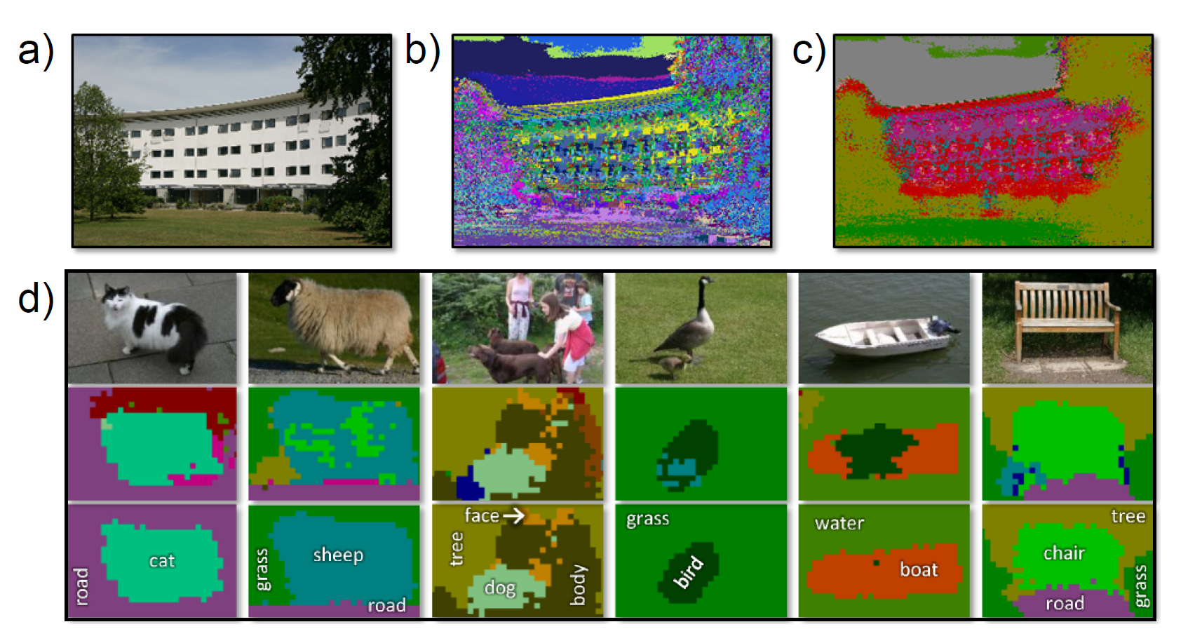
Classification Example 4: Semantic Segmentation

Slide 40

Worked example 2: Classification
Consider simple case where
we make a univariate continuous measurement x
use this to predict a discrete binary world
w
(classification as world state is discrete)

Slide 41
Type 1: Model Pr(w|x) - Discriminative
How to model Pr(w|x)?
Choose an appropriate form for Pr(w)
Make parameters a function of x
Function takes parameters θ that define its shape
Learning algorithm: learn parameters θ from training data x,w
Inference algorithm: just evaluate Pr(w|x)

Slide 42
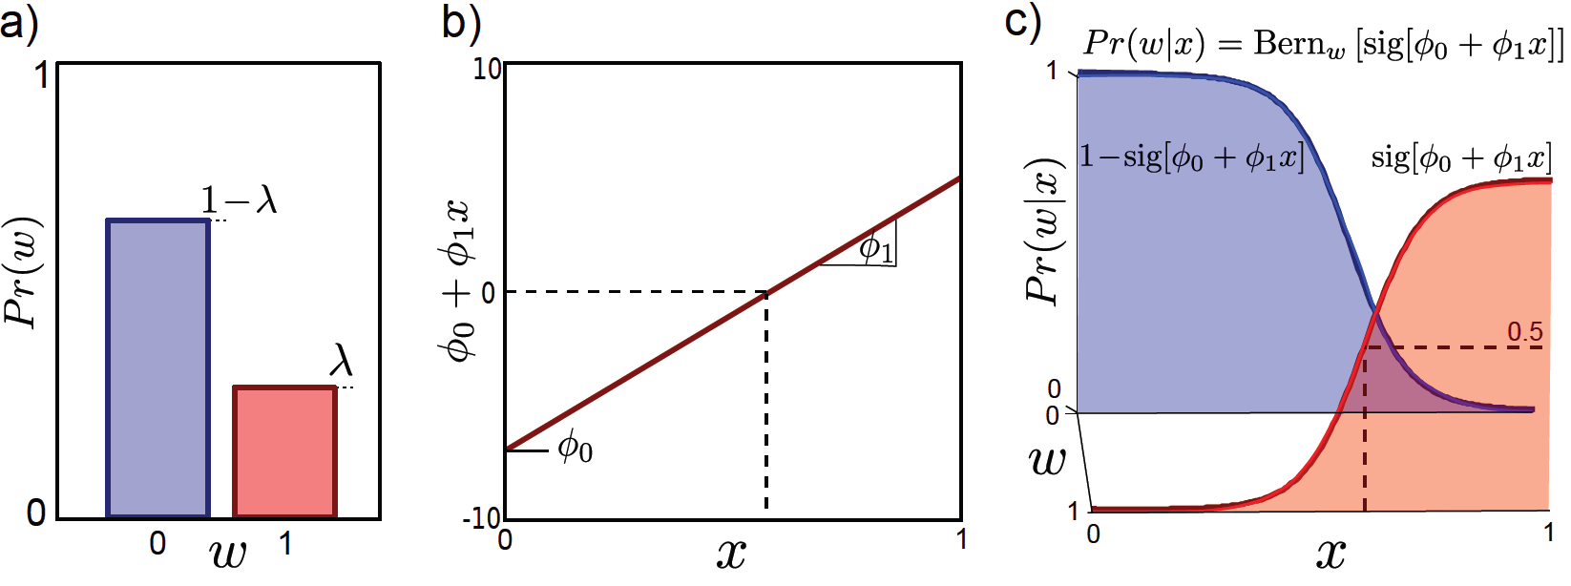
Type 1: Model Pr(w|x) - Discriminative
How to model Pr(w|x)?
Choose an appropriate form for Pr(w)
Make parameters a function of x
Function takes parameters θ that define its shape
Choose Bernoulli dist. for Pr(w)
Make parameters a function of x
Function takes parameters φ₀ and φ₁
This model is called logistic regression.

Slide 43
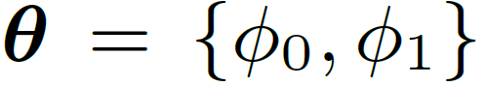
Two parameters
Learning by standard methods (ML,MAP, Bayesian)
Inference: Just evaluate Pr(w|x)

Slide 44
Type 2: Model Pr(x,w) - Generative
How to model Pr(x,w)?
Concatenate x and w to make z= [x^{T} w^{T}]^{T}
Model the pdf of z
Pdf takes parameters θ that define its shape
Learning algorithm: learn parameters θ from training data x,w
Inference algorithm: compute Pr(w|x) using Bayes rule

Slide 45
Type 2 Model
Can’t build this model very easily:
Concatenate continuous vector x and discrete w to make z
No obvious probability distribution to model joint probability of discrete and continuous

Slide 46

Type 3: Pr(x|w) - Generative
How to model Pr(x|w)?
Choose an appropriate form for Pr(x)
Make parameters a function of w
Function takes parameters θ that define its shape
Learning algorithm: learn parameters θ from training data x,w
Inference algorithm: Define prior Pr(w) and then compute Pr(w|x) using Bayes’ rule

Slide 47
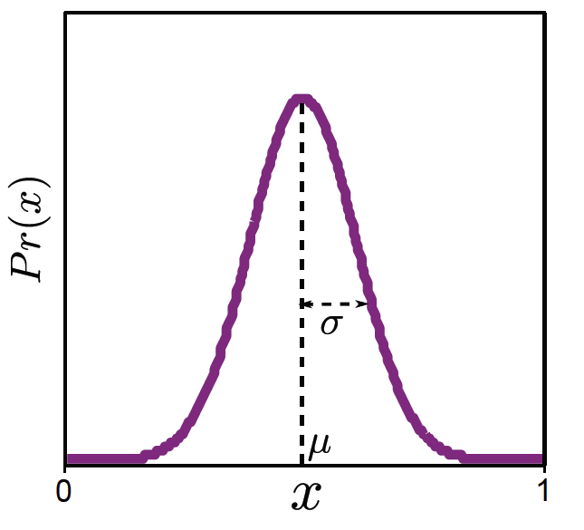
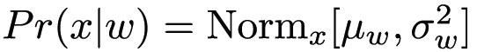
Type 3: Pr(x|w) - Generative
How to model Pr(x|w)?
Choose an appropriate form for Pr(x)
Make parameters a function of w
Function takes parameters θ that define its shape
Choose a Gaussian distribution for Pr(x)
Make parameters a function of discrete binary w
3. Function takes parameters μ₀, μ₁, σ²₀, σ²₁ that define its shape

Slide 48
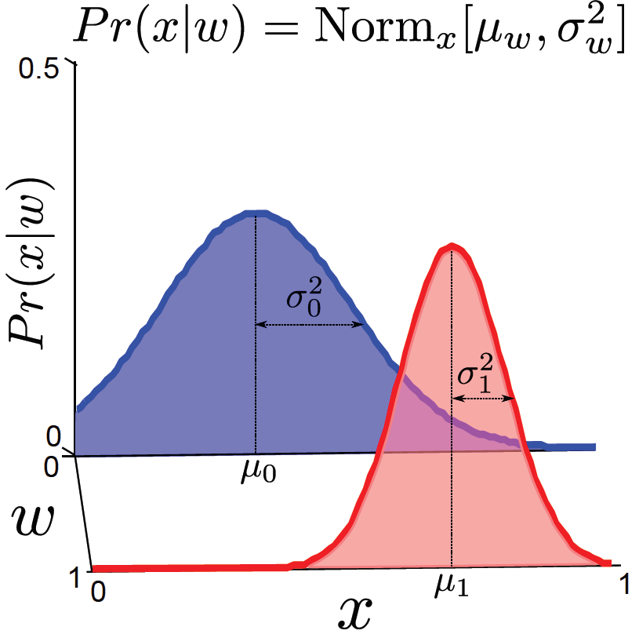







Learn parameters μ₀, μ₁, σ²₀, σ²₁ that define its shape

Slide 49
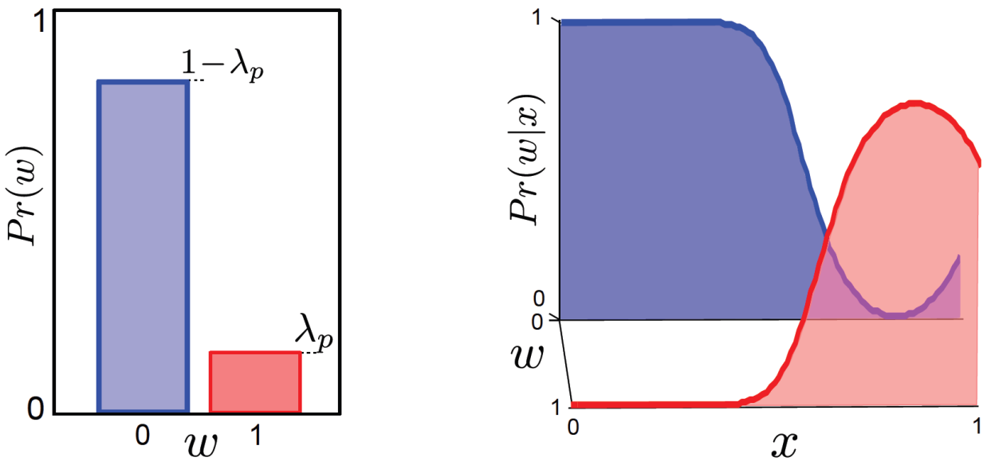




Inference algorithm: Define prior Pr(w) and then compute Pr(w|x) using Bayes’ rule

Slide 50
Structure
Computer vision models
Three types of model
Worked example 1: Regression
Worked example 2: Classification
Which type should we choose?
Applications
Computer vision: models, learning and inference. ©2011 Simon J.D. Prince
50

Slide 51
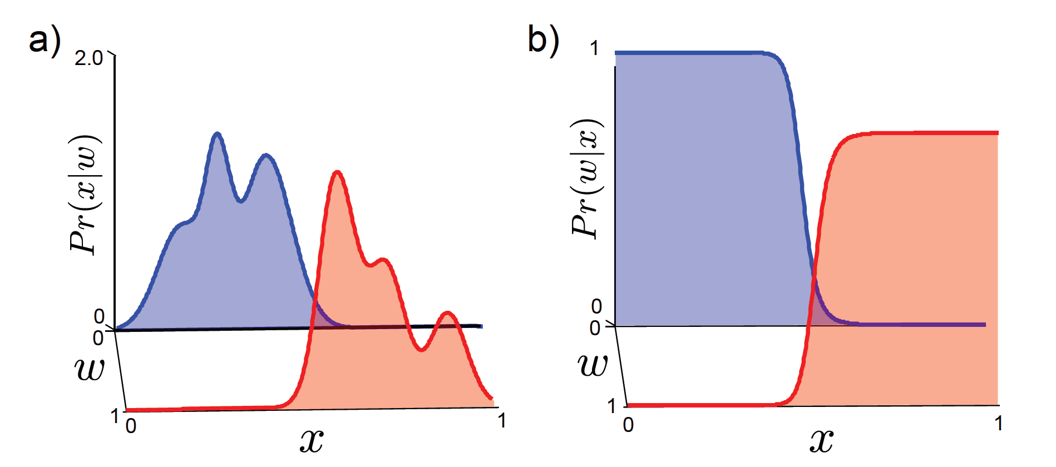
Which type of model to use?
Generative methods model data – costly and many aspects of data may have no influence on world state

Slide 52

Which type of model to use?
Inference simple in discriminative models
Data really is generated from world – generative matches this
If missing data, then generative preferred
Generative allows imposition of prior knowledge specified by user

Slide 53
Structure
Computer vision models
Three types of model
Worked example 1: Regression
Worked example 2: Classification
Which type should we choose?
Applications
Computer vision: models, learning and inference. ©2011 Simon J.D. Prince
53

Slide 54
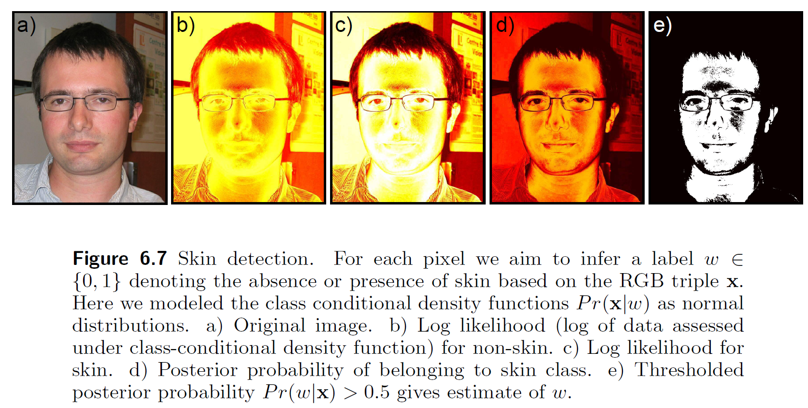
Application: Skin Detection
Computer vision: models, learning and inference. ©2011 Simon J.D. Prince
54

Slide 55
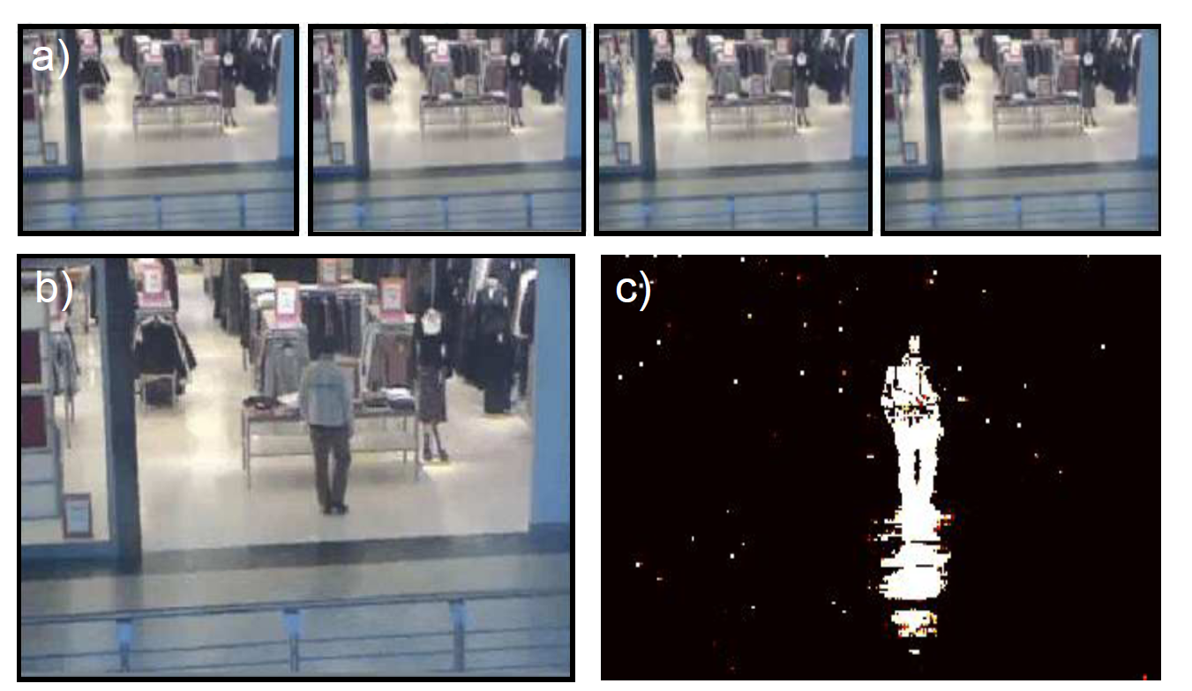
Application: Background subtraction
Computer vision: models, learning and inference. ©2011 Simon J.D. Prince
55

Slide 56
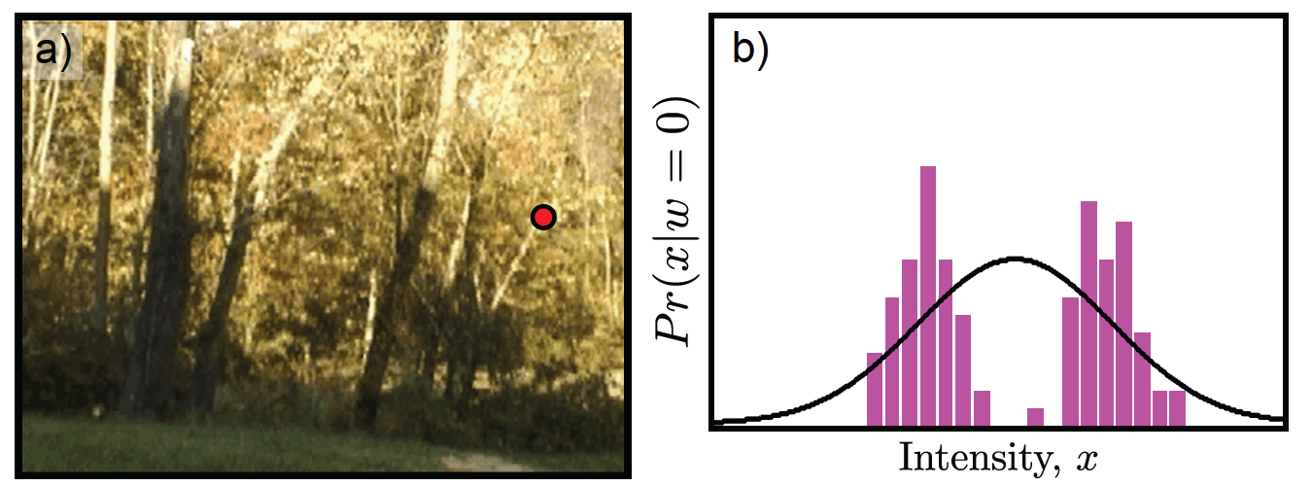
Application: Background subtraction
But consider this scene in which the foliage is blowing in the wind. A normal distribution is not good enough! Need a way to make more complex distributions
Computer vision: models, learning and inference. ©2011 Simon J.D. Prince
56

Slide 57
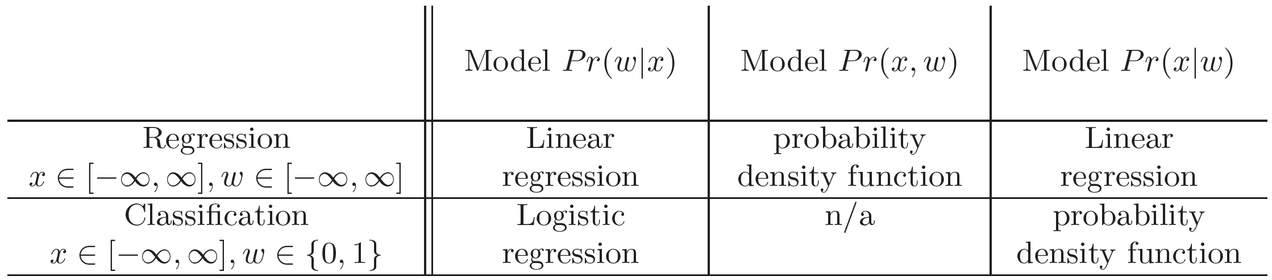
Future Plan
Seen three types of model
Probability density function
Linear regression
Logistic regression
Next three chapters concern these models
Computer vision: models, learning and inference. ©2011 Simon J.D. Prince
57

Slide 58
Conclusion
To do computer vision we build a model relating the image data x to the world state that we wish to estimate w
Three types of model
Model Pr(w|x) -- discriminative
Model Pr(w,x) -- generative
Model Pr(w|x) – generative

